Slide 1
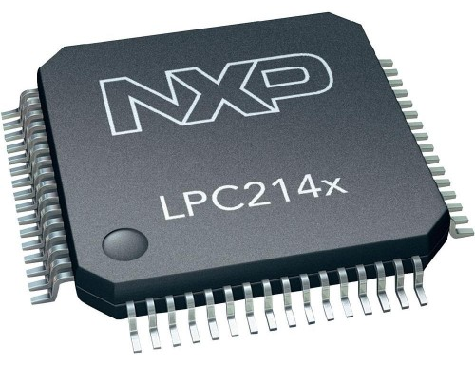
NXP’s LPC2148
Peeyush K. P.
Assistant Professor
Department of Electronics and Communication Engineering
Amrita School of Engineering
Coimbatore

Slide 2
NXP’s LPC2148
Architecture

Slide 3
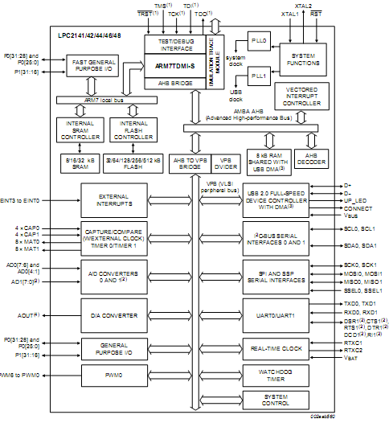
LPC 2148 ARCHITECTURE

Slide 4
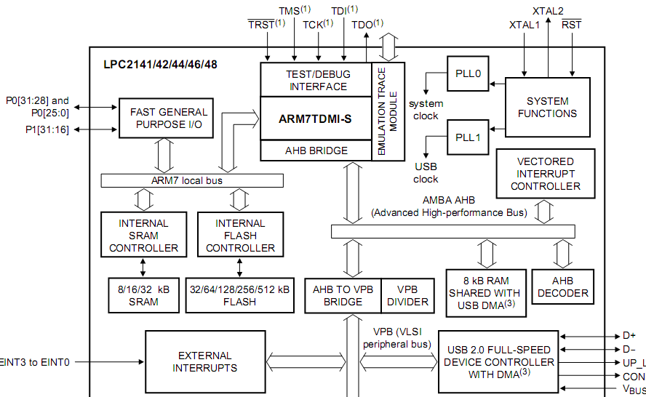
LPC 2148 ARCHITECTURE

Slide 5
NXP’s LPC2148
GPIO
Peeyush.K.P.
Amrita School of Engineering
Coimbatore

Slide 6
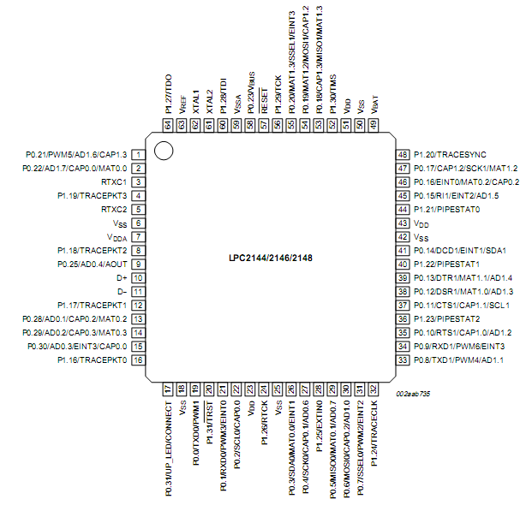
PIN DIAGRAM – GPIO
P0 – 30 Pins
P1 – 16 Pins
PORTS
P0.0 – P0.25
P0.28 – P0.31
P1.16 – P1.31

Slide 7
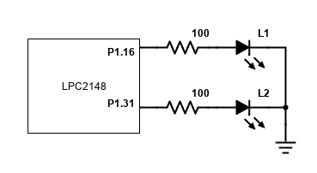
LED Blinking - GPIO

Slide 8
STEPS TO BLINK LEDs
1) Configure functionality of P1.31 to P1.16 as GPIO Port
PINSEL2 = 0;
2) Configure Direction of P1.31 to P1.16 as Output Port
IODIR1 = 0xFFFFFFFF;
Switch on all LEDs on Port1 (Configure Data as Logic High)
IOSET1 = 0XFFFFFFFF;
Switch off all LEDs on Port1 (Configure Data as Logic Low)
IOCLR1 = 0XFFFFFFFF;

Slide 9
STEPS TO BLINK LEDs
1) Configure functionality of P1.31 to P1.16 as GPIO Port
PINSEL2 = 0;

Slide 10
PINSEL Registers
PINSEL0 – P0.0 to P0.15
PINSEL1 – P0.16 to P0.31
PINSEL2 – P1.16 to P1.31

Slide 11
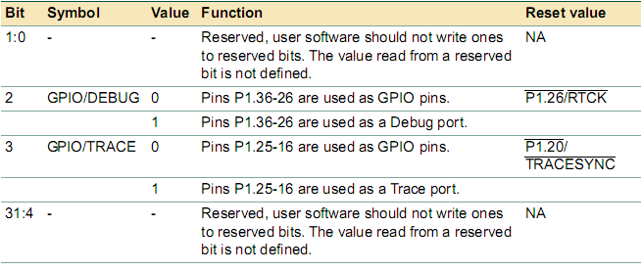
PINSEL2 REGISTER
PINSEL2 = 0;

Slide 12
STEPS TO BLINK LEDs
2) Configure Direction of P1.31 to P1.16 as Output Port
IODIR1 = 0xFFFFFFFF;

Slide 13
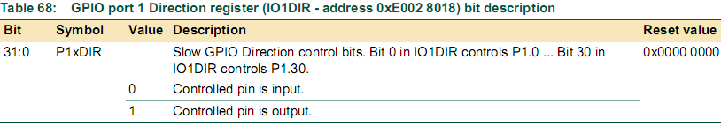
IODIR1 (Direction Register)
Bit 31 | …… | Bit 17 | Bit 16 | ….. | Bit 2 | Bit 1 | Bit 0
 |  |  |  |  |  |  | ??
P1.31 | …… | P1.17 | P1.16 | ….. | P1.2 | P1.1 | P1.0
IODIR1 = 0xFFFFFFFF;

Slide 14
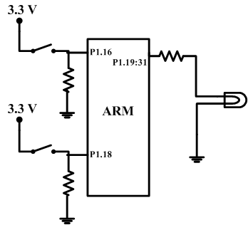
IODIR1 (Direction Register)
IODIR1 = 0xFFFAFFFF;
1111 1111 1111 1010 1111 1111 1111 1111
LEDs
Switches

Slide 15
STEPS TO BLINK LEDs
Switch on all LEDs on Port1 (Configure Data as Logic High)
IOSET1 = 0XFFFFFFFF;

Slide 16
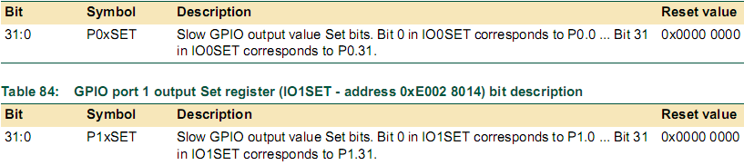
IOSETx (Data Register - Set)
Bit 31 | …… | Bit 17 | Bit 16 | ….. | Bit 2 | Bit 1 | Bit 0
 |  |  |  |  |  |  | ??
P1.31 | …… | P1.17 | P1.16 | ….. | P1.2 | P1.1 | P1.0
1- Set
IOSET1 = 0XFFFFFFFF;

Slide 17
STEPS TO BLINK LEDs
Switch off all LEDs on Port1 (Configure Data as Logic Low)
IOCLR1 = 0XFFFFFFFF;

Slide 18
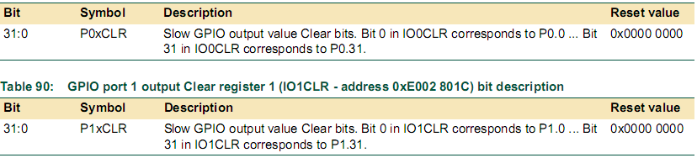
IOCLRx (Data Register - Clear)
Bit 31 | …… | Bit 17 | Bit 16 | ….. | Bit 2 | Bit 1 | Bit 0
P1.31 | …… | P1.17 | P1.16 | ….. | P1.2 | P1.1 | P1.0
1- Clear
IOCLR1 = 0XFFFFFFFF;

Slide 19
STEPS TO BLINK LEDs
1) Configure functionality of P1.31 to P1.16 as GPIO Port
PINSEL2 = 0;
2) Configure Direction of P1.31 to P1.16 as Output Port
IODIR1 = 0xFFFFFFFF;
Switch on all LEDs on Port1 (Configure Data as Logic High)
IOSET1 = 0XFFFFFFFF;
4) Delay
5) Switch off all LEDs on Port1 (Configure Data as Logic Low)
IOCLR1 = 0XFFFFFFFF;
6) Delay

Slide 20
Register Summary - GPIO
 | 15 14 | 13 12 | 11 10 | 9 8 | 7 6 | 5 4 | 3 2 | 1 0
PINSEL0 | P0.7 | P0.6 | P0.5 | P0.4 | P0.3 | P0.2 | P0.1 | P0.0
 | 31 30 | 29 28 | 27 26 | 25 24 | 23 22 | 21 20 | 19 18 | 17 16
PINSEL0 | P0.15 | P0.14 | P0.13 | P0.12 | P0.11 | P0.10 | P0.9 | P0.8
 | 15 14 | 13 12 | 11 10 | 9 8 | 7 6 | 5 4 | 3 2 | 1 0
PINSEL1 | P0.23 | P0.22 | P0.21 | P0.20 | P0.19 | P0.18 | P0.17 | P0.16
 | 31 30 | 29 28 | 27 26 | 25 24 | 23 22 | 21 20 | 19 18 | 17 16
PINSEL1 | P0.31 | P0.30 | P0.29 | P0.28 | P0.27 | P0.26 | P0.25 | P0.24
 | 15 14 | 13 12 | 11 4 | 3 | 2 | 1 0
PINSEL2 |  |  |  | GPIO/TRACE | GPIO/DEBUG | SEL

Slide 21
Input – Output
LED Control Through Switch

Slide 22
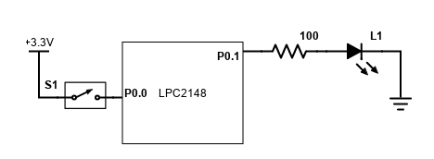
LED Control using Switch - GPIO

Slide 23
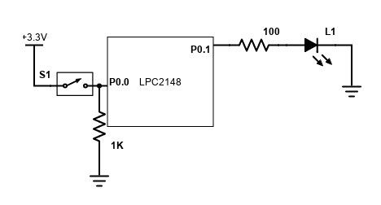
LED Control using Switch - GPIO

Slide 24
STEPS FOR LED CONTROL USING SWITCH
1) Configure functionality of P0.0 and P0.1 as GPIO Port
PINSEL0 = 0x00000000;
2) Configure Direction of P0.0 as Input Pin
IO0DIR &= 0xFFFFFFFE;
3) Configure Direction of P0.1 as Output Pin
IO0DIR |= 0x00000002;
4) Check if Switch connected to P0.0 is Pressed
if((IOPIN0 & 0x01)==1)
5) If Pressed, Switch ON LED connected to P0.1
IOSET0 |= 0x00000002;
6) Else Switch OFF LED connected to P0.1
IOCLR0 |= 0x00000002;

Slide 25
STEPS FOR LED CONTROL USING SWITCH
1) Configure functionality of P0.0 and P0.1 as GPIO Port
PINSEL0 = 0x00000000;

Slide 26
PINSEL Registers
PINSEL0 – P0.0 to P0.15
PINSEL1 – P0.16 to P0.31
PINSEL2 – P1.16 to P1.31

Slide 27
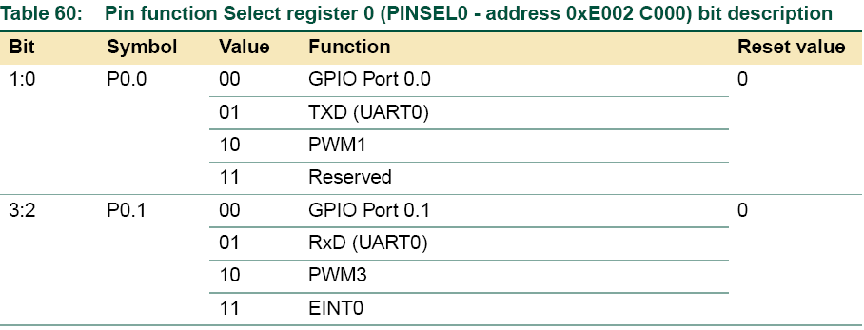
PINSEL0 REGISTER
PINSEL0 = 0x00000000;

Slide 28
STEPS FOR LED CONTROL USING SWITCH
2) Configure Direction of P0.0 as Input Pin
IO0DIR &= 0xFFFFFFFE;

Slide 29
IODIR0 (Direction Register)
Bit 31 | …… | Bit 17 | Bit 16 | ….. | Bit 2 | Bit 1 | Bit 0
 |  |  |  |  |  |  | 0
P0.31 | …… | P0.17 | P0.16 | ….. | P0.2 | P0.1 | P0.0
Clear
1111
& 1101
1101
IO0DIR &= 0xFFFFFFFE;

Slide 30
STEPS FOR LED CONTROL USING SWITCH
3) Configure Direction of P0.1 as Output Pin
IO0DIR |= 0x00000002;

Slide 31
IODIR0 (Direction Register)
Bit 31 | …… | Bit 17 | Bit 16 | ….. | Bit 2 | Bit 1 | Bit 0
 |  |  |  |  |  | 1
P0.31 | …… | P0.17 | P0.16 | ….. | P0.2 | P0.1 | P0.0
Set
1101
| 0010
1111
IO0DIR |= 0x00000002;

Slide 32
STEPS FOR LED CONTROL USING SWITCH
4) Check Switch connected to P0.0 is Pressed
if((IOPIN0 & 0x01)==1)

Slide 33
IOPIN0 (Data Register)
Bit 31 | …… | Bit 17 | Bit 16 | ….. | Bit 2 | Bit 1 | Bit 0
 |  |  |  |  |  |  | RD
P0.31 | …… | P0.17 | P0.16 | ….. | P0.2 | P0.1 | P0.0
Split a Bit
1111
& 0010
0010
if((IOPIN0 & 0x01)==1)

Slide 34
STEPS FOR LED CONTROL USING SWITCH
5) If Pressed, Switch ON LED connected to P0.1
IOSET0 |= 0x00000002;

Slide 35
IOSET0 (Data Register - Set)
Bit 31 | …… | Bit 17 | Bit 16 | ….. | Bit 2 | Bit 1 | Bit 0
 |  |  |  |  |  | 1
P0.31 | …… | P0.17 | P0.16 | ….. | P0.2 | P0.1 | P0.0
1- Set
IOSET0 |= 0x00000002;

Slide 36
STEPS FOR LED CONTROL USING SWITCH
6) Else Switch OFF LED connected to P0.1
IOCLR0 |= 0x00000002;

Slide 37
IOCLR0 (Data Register - Clear)
Bit 31 | …… | Bit 17 | Bit 16 | ….. | Bit 2 | Bit 1 | Bit 0
P0.31 | …… | P0.17 | P0.16 | ….. | P0.2 | P0.1 | P0.0
1- Clear
IOCLR0 |= 0x00000002;

Slide 38


